Slide 1
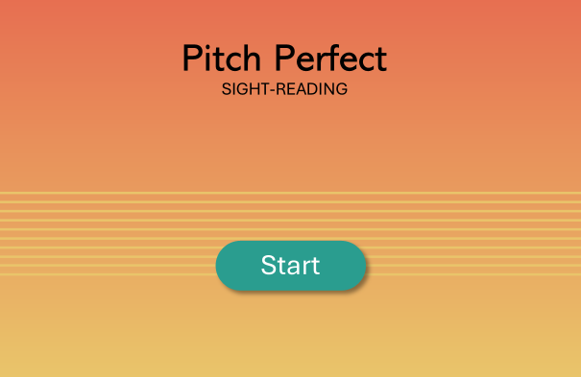
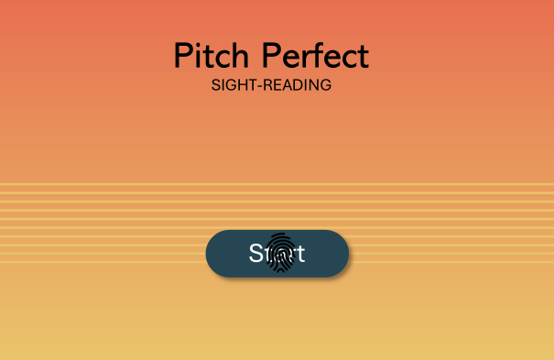
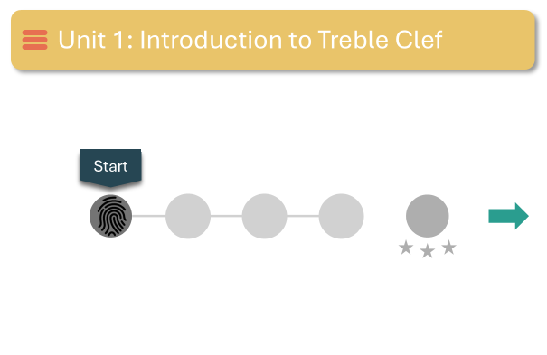
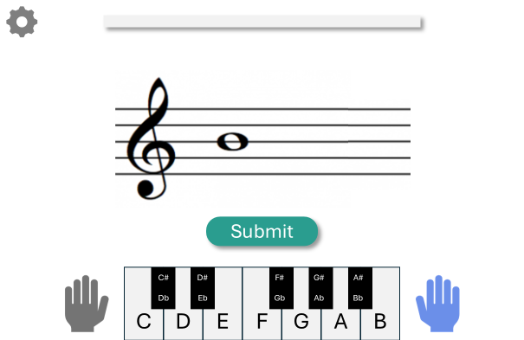
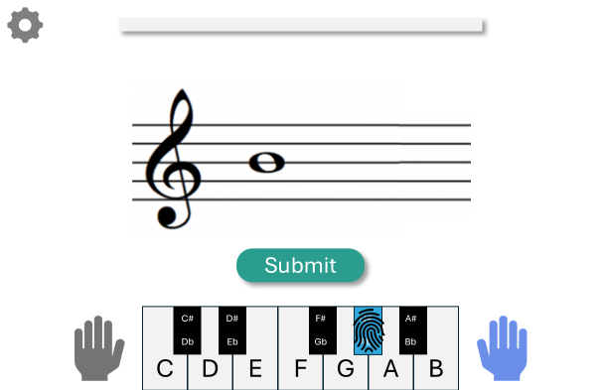
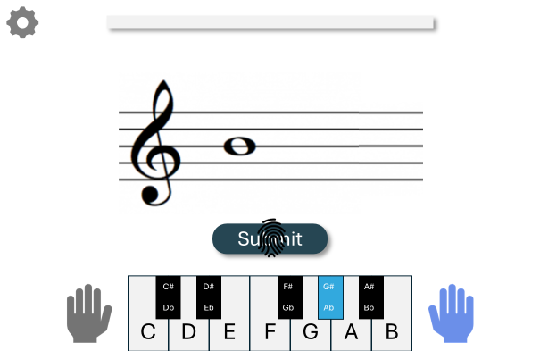
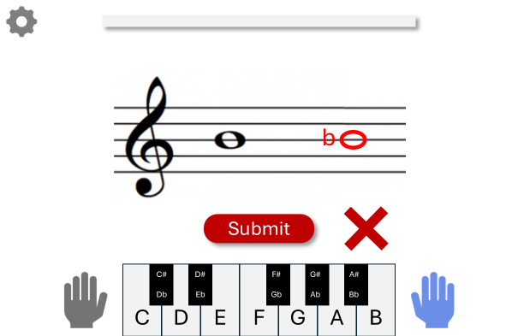
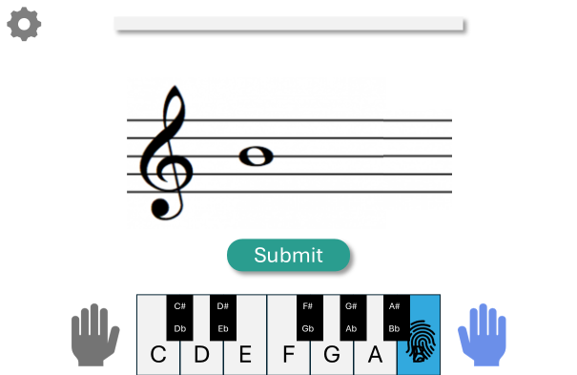

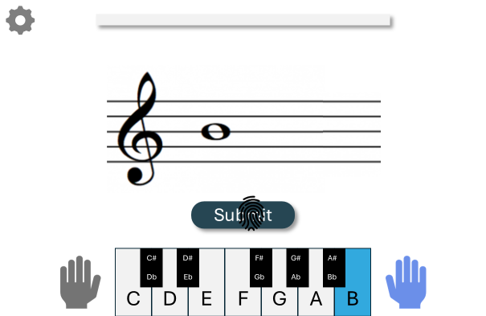
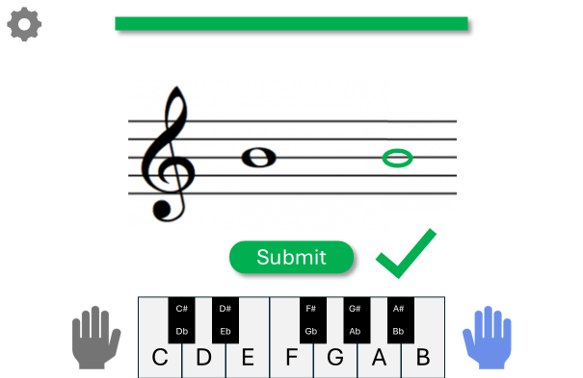
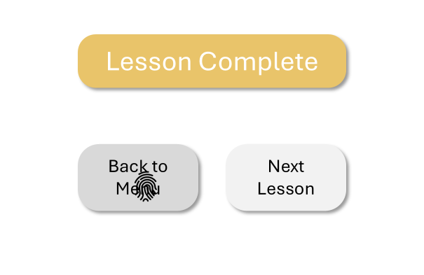
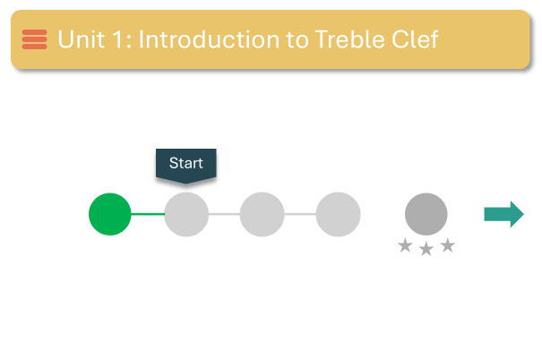
User is greeted with launch screen when first opening app
User selects start option
User lands on navigation menu and taps to begin lesson
Lesson begins: the user is presented a note to identify
User touches a note on screen to select a note. That note is played through the device for the user to hear.
User submits their guess
Wrong answer: returns to the default state in panel 4 for user to try again
User can try again
User submits again
User gets the correct answer
The user completes the lesson and returns to navigation menu
Navigation menu is updated with completed drill

Slide 2
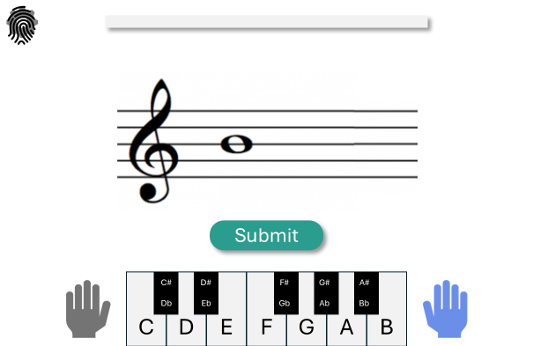
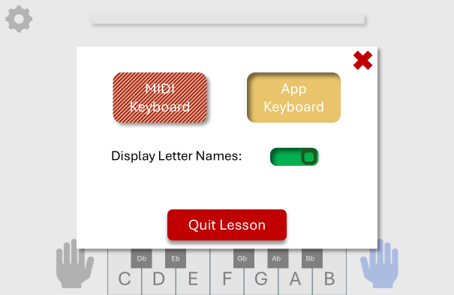
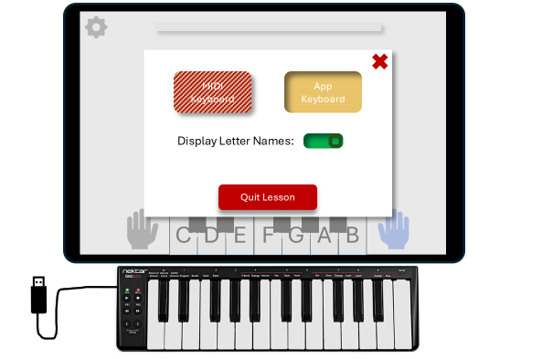
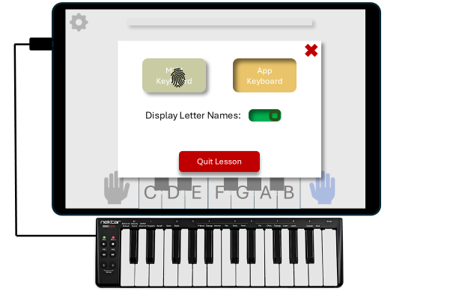
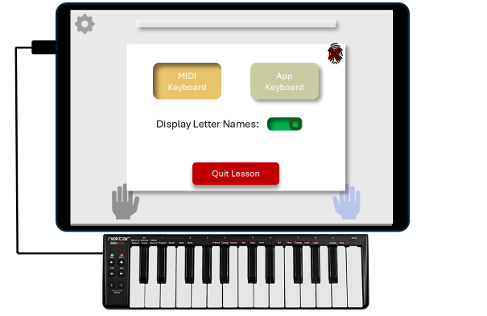
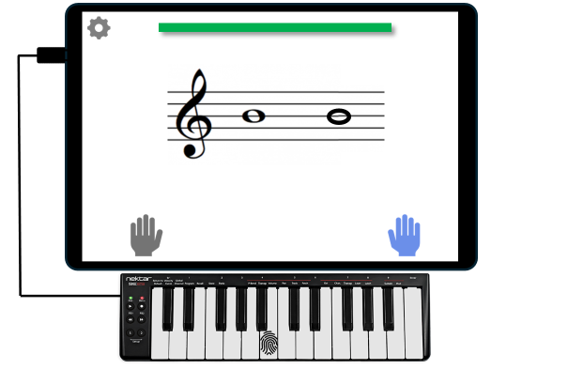
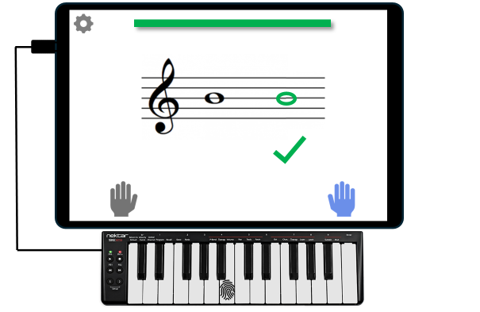
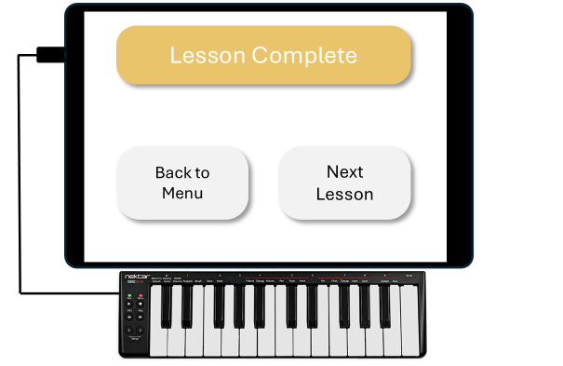
User taps the gear icon to open the menu
User is presented with the menu: Currently no midi is connected
User gets their NEKTAR SE25 MIDI Keyboard
User connects the device: Option to choose MIDI device is now available
User closes menu
User submits their guess via MIDI Keyboard. The corresponding note is played for the user to hear.
User gets the right answer
User can try again

Slide 3
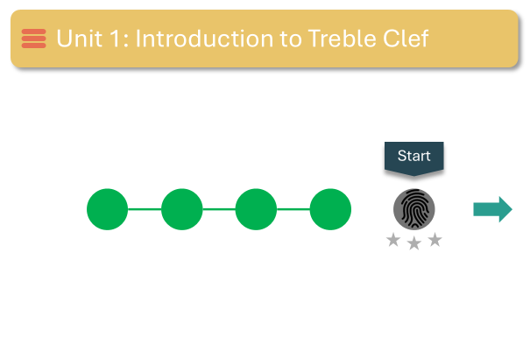
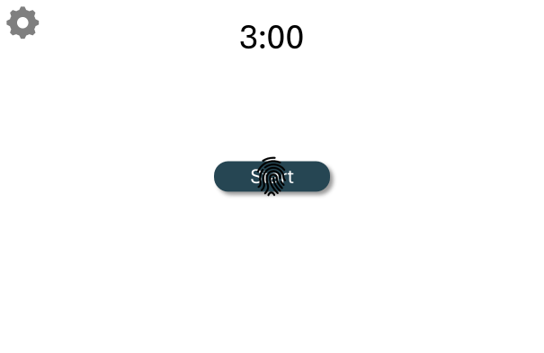
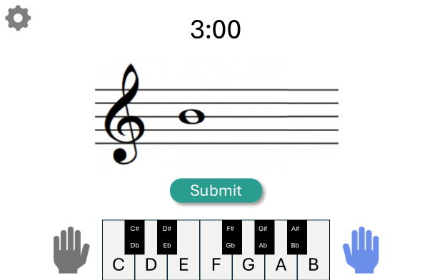
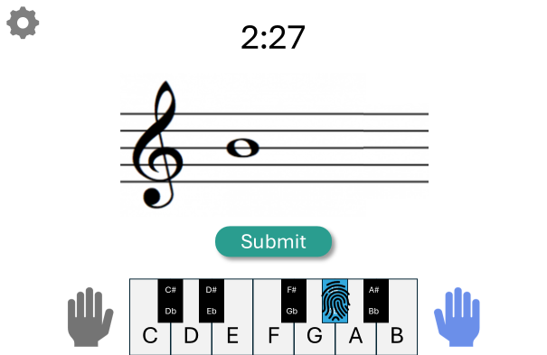
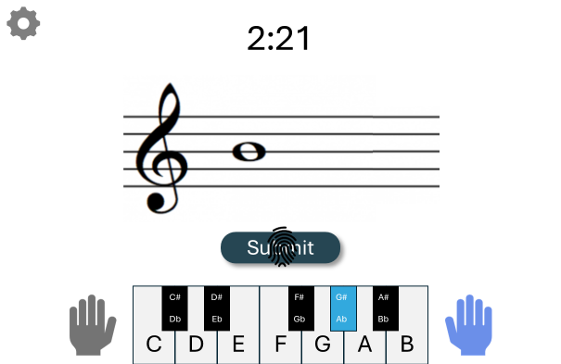
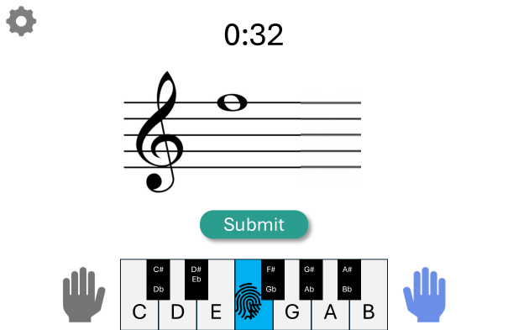
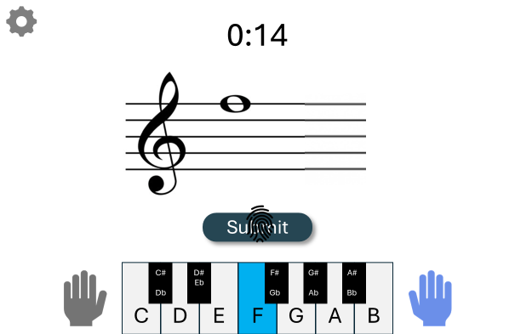
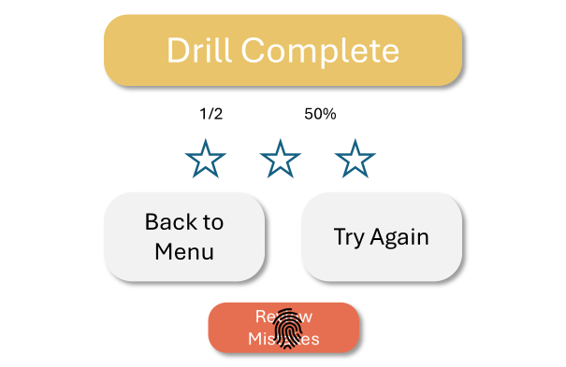
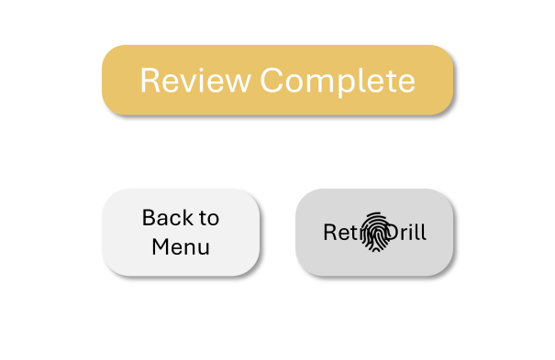
User has finished all lessons in unit 1 and proceeds to do the drill
User starts drill
Drill begins: The user is presented with problems while timer counts down
User touches note that he guesses. Note is played through speaker.
User submits their guess
User is immediately presented with a next note to identify.
User continues guessing until time runs out
Drill is finished and user chooses to review their wrong answers
The answer they got wrong is compiled in a lesson for them to complete
User tries the problem from the review
User gets it right
The user finished the review and chooses to retry the drill. This brings them back to panel 2

